Slide 1
MP 3
Cameron, jude, Julia, katherine

Slide 2
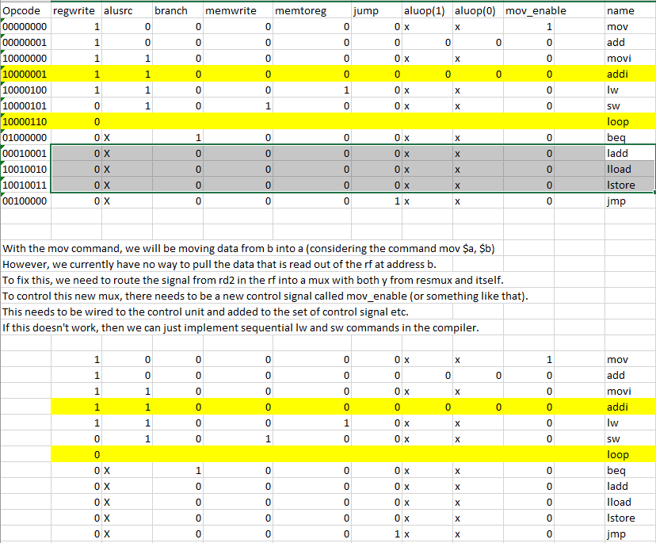
Control Unit Design

Slide 3

Program Demo

Slide 4

Hardware Bugs
Memory
Opcodes in List Processor
ALU output in List Processor
Making the jump command work
Register 0 always being 0
Other miscellaneous bugs

Slide 5

Final Thoughts

